Slide 1
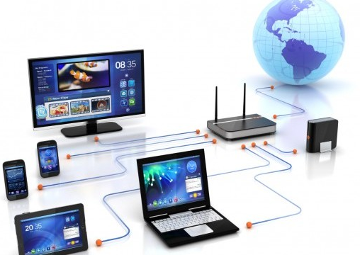
Computer Networks
Chapter 6 - Lecture 4
Dhanusha Somawardhana
BSc(Hons) IT (SLIIT), MBA(Uow), Reading DBA(AeU)

Slide 2

Introduction
A collection of computing devices that are connected in various ways in order to communicate and share resources.
The generic term node or host refers to any device on a network
Data transfer rate The speed with which data is moved from one place on a network to another

Slide 3
Network Architecture – Objectives of Components
Connectivity – H/W Components are built in conformance to the standards, must be able to communicate with each other over the network.
Flexibility - Upgradation must be possible without the need for costly new interfaces or software
Modularity - the hardware and software modules must be capable of production in large quantities.
Reliability - Providing appropriate error detection and correction capabilities.
Simplicity - The network should permit its easy implementation, installation and reconfiguration.
Diversity - Provide a variety of services and at the same time, isolating the user from the network structure or implementation details.

Slide 4
Components of a Network
Hardware components of a network can be summarized as:
Communicating machines.
Physical transmission media.
Interfaces
The software aspect of communication via a network.
Protocols that define the set of rules for communication.
Network software that performs various networks related functions such as data routing, error detection and correction etc. ex: packet tracer

Slide 5
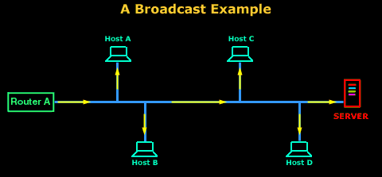
Transmission Technologies
Broadcast networks
Architecture of networks in which there is a single communication channel, which is shared by all the machines connected to the network.
Short messages called packets are sent by any machine and are received by the rest.
This packet contains an address field, which contains the address of the machine the packet is meant for.

Slide 6
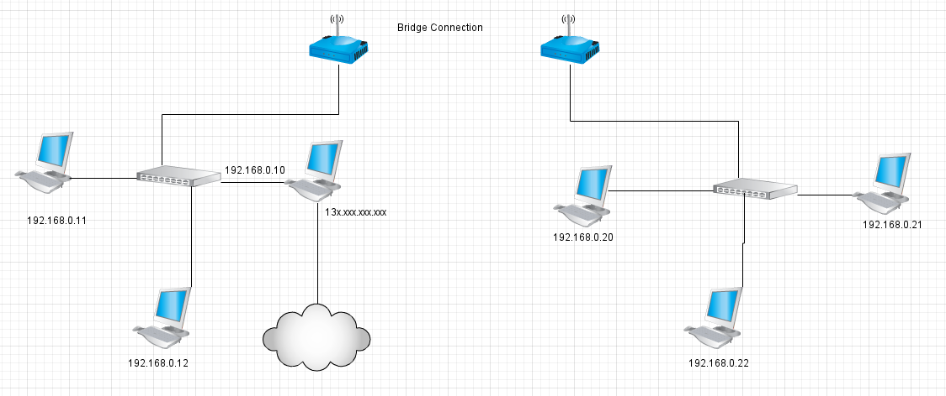
Cont.
Point-to-point networks
All the individual machines are interconnected.
Packets, in point-to-point networks often have to travel through one or more intermediate machines before they finally reach the destination machine.

Slide 7
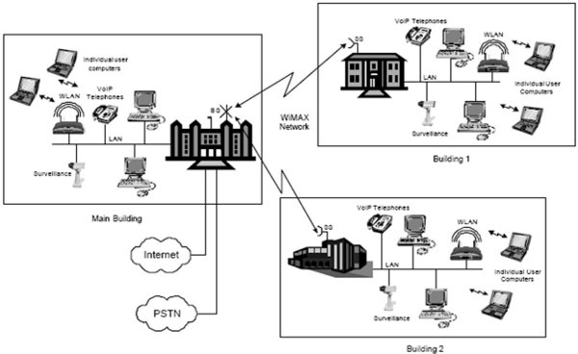
Transmission Medium
The actual transmission of information in a computer network takes place via a transmission medium.
Two Types
Guided Media - Can be termed as that medium where the packets are directed towards the destination.
Un-Guided Media - information is transmitted irrespective of the location of the destination machine

Slide 8
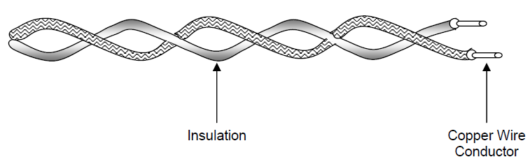
Cont.
Magnetic Media - Ex: Floppy Disk
Twisted Pair –
Consists of two insulated copper wires.
Can be used for both analog and digital transmission
Transmission rate of several megabits per second can be achieved.
Performance and low cost

Slide 9
Cont.
Coaxial Cable –
Has better shielding than twisted pair.
Can span longer distance at relatively higher speed.
Stiff copper wire as the core, which is surrounded by an insulating material.
Ex. TV antenna wire
Two Types –
The baseband coaxial cable - 1 to 2 Gbps is possible for a 1-km cable
The broadband coaxial cable - 450 MHz and can span for nearly 100 kms for analog transmission. Ex (TV Cable)

Slide 10
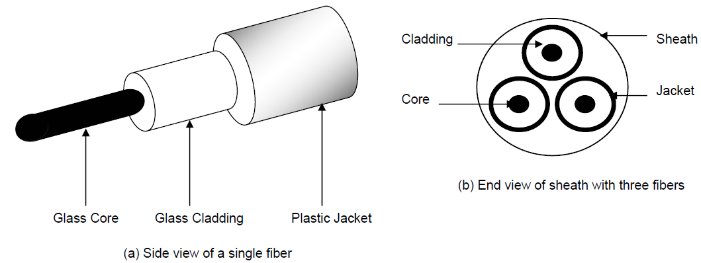
Optical Fibers
Employ the medium of light to transmit information.
Information can be transmitted at very high speed - the speed of light.
Eliminates problems like heat dissipation.
Can convert optical signals to electrical signals and vice versa at such a fast rate.

Slide 11
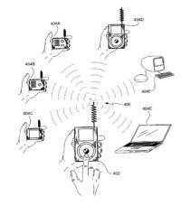
Wireless Transmission
Radio Transmission
Microwave Transmission
Infrared and Millimeter Waves
Light wave Transmission

Slide 12

Signal to Noise Ratio
Way of measuring the sensitivity performance of the receiver.

Slide 13
External Communication Systems
ISDN –
Integrated Services Digital Network, set of digital transmission protocols defined by CCITT (ITU).
ISDN integrates the data, voice and video signals into a digital telephone line.
It handles all types of information.
FDDI –
Fiber Distributed Data Interface, a set of ANSI protocols for sending digital data over fiber optic cable.
Typically used as backbones for wide-area networks.

Slide 14
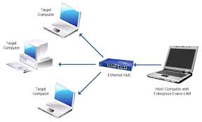
Local Area Networks (LAN)
Can be defined as privately owned networks that generally span an entire building or up to a few kilometers in size.
Often use a single cable to connect the resources.
Divided into static and dynamic.
Static LANs divide time into fixed slots and providing each machine with a slot.
Dynamic LANs have a centralized unit a bus arbitration unit, which decides which machine, will transmit next.

Slide 15
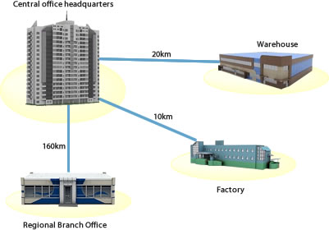
Metropolitan Area Networks (MAN)
Similar technology as that of LAN - The area coverage of MANs is more than LANs.
Used to mean the interconnection of several local area networks by bridging them with backbone lines.

Slide 16
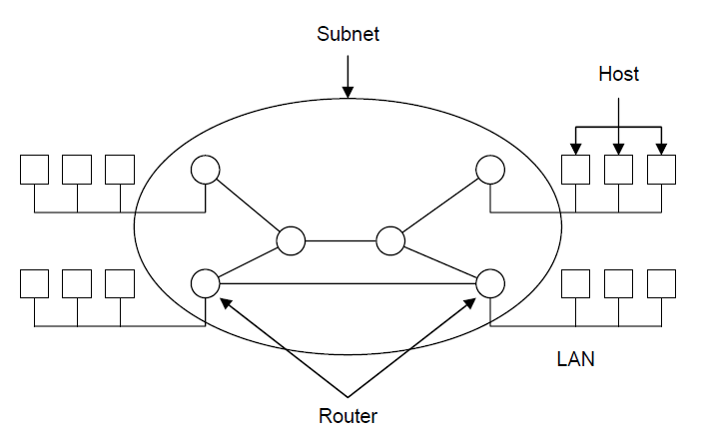
Wide Area Networks (WAN)
Network spans a large geographical area.
The structure of a WAN consists of a number of host machines connected by a communication subnet.
The main function of the subnet is to transfer data from one host to another.

Slide 17
Network Topologies
The computers and other resources are organized in a network in various methods.
This organization is called network topology.

Slide 18
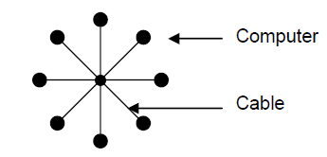
Star Topology
A number of other machines are connected to a centralized machine.
Entire network fails when the central hub goes down.
Can be corrected by maintaining a back up hub.
The traffic near the central hub is very high which decreases the overall performance of the network.

Slide 19
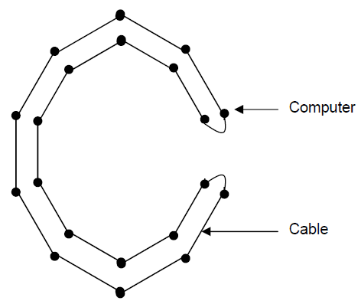
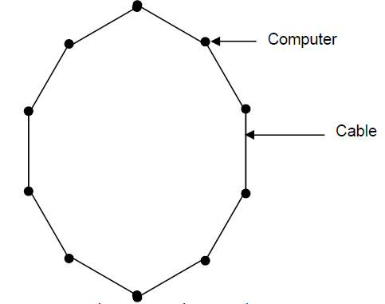
Ring Topology
The transmission line is organized like a ring.
Has the disadvantage that the entire network fails whenever there is a breakage in the transmission line.
This kind of situation can be avoided by maintaining two rings

Slide 20
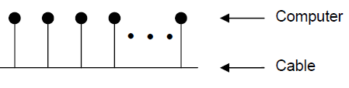
Bus Topology
All the machines are connected to a linear transmission line.
Only one machine can transmit data at a time.
An arbitration mechanism is required to resolve conflicts that may arise from two or more machines trying to transmit simultaneously.

Slide 21
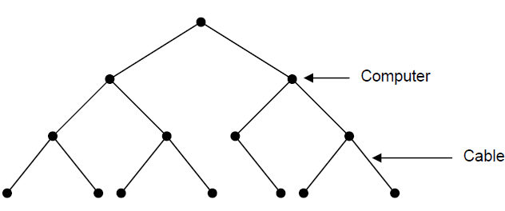
Tree Topology
Hierarchical Design

Slide 22
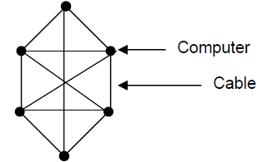
Mesh Topologies
Each machine is connected to each other.
Advantage that data is transferred at a much faster rate.
Reduces concentration of network traffic at one point.

Slide 23
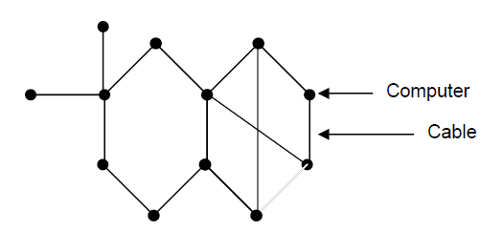
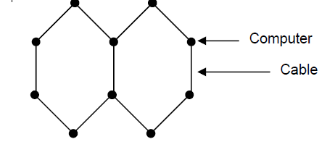
Other Topologies
A combination of two or more of the models.

Slide 24
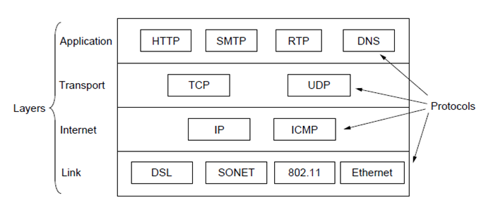
Protocols
Specify the rules, procedures and conventions for data transfer and communication over the network.

Slide 25
Concepts of Protocols
Initiation and Termination Control
Establishing the connection and terminating the connection.
Acknowledgment –
Ensure the connectivity and Data Transfer
Formatting –
Referred to as framing.
Data transfer in a network is carried on by using packets.
A packet can be defined as the smallest unit, comprising of a group of bits.
Formatting specifies which group of bits in a packet constitutes data, control, addressing or other information.

Slide 26
Cont.
Sequence Control
The sequence in which the packets are received by the destination computer is different from the sequence in which the packets were sent by the source computer.
Sequence control mechanism, which will rearrange the packets received by the destination computer in an order in which they were sent by the source computer.
Flow Control
concerned with the optimum utilization of network resources for data transfer and spans mechanisms
Error Control –
Refers to the set of procedures that are used to ensure error free transmission of data over the network.
Involves an error detection mechanism and retransmission of messages in which error were detected.

Slide 27
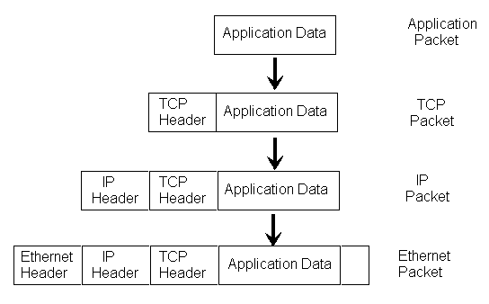
Cont.
Recovery Control –
The mechanism for the recovery in abnormal termination of the connections.

Slide 28
Design issues of Layers
The need of each layer to identify the senders and receivers.
Simplex communication
In this form of communication, data can travel in only one direction. Thus, there is one sender and one or many receivers.
Half-duplex communication
Half-duplex communication allows data transfer in both direction but only in one direction at any point of time.
Full-duplex communication
In systems that support full-duplex communication, data transfer can take place in both directions simultaneously

Slide 29
Connection-Oriented and Connectionless Services
Connection-Oriented Services –
The service user must first establish a connection between the sender and the receiver
Then proceed with the transfer.
Once the transfer is over, the user then releases the connection.
Connectionless Services –
Do not require a connection between the sender and the receiver.
Each packet contains the full address of the destination.
The receiver must acknowledge the receipt of each message for the sender to be sure that the message is received.

Slide 30
Thank You…!!!

